Slide 1
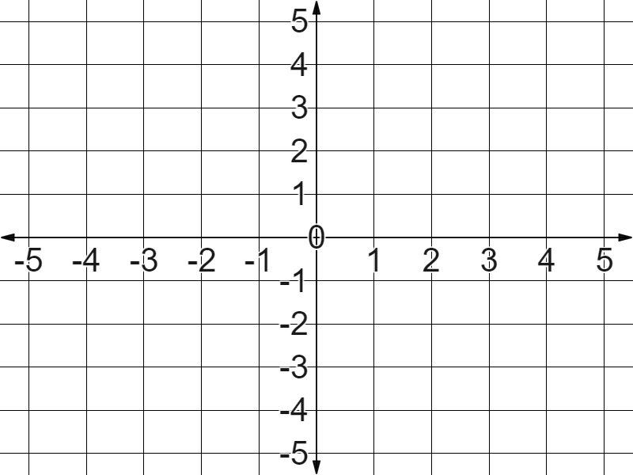

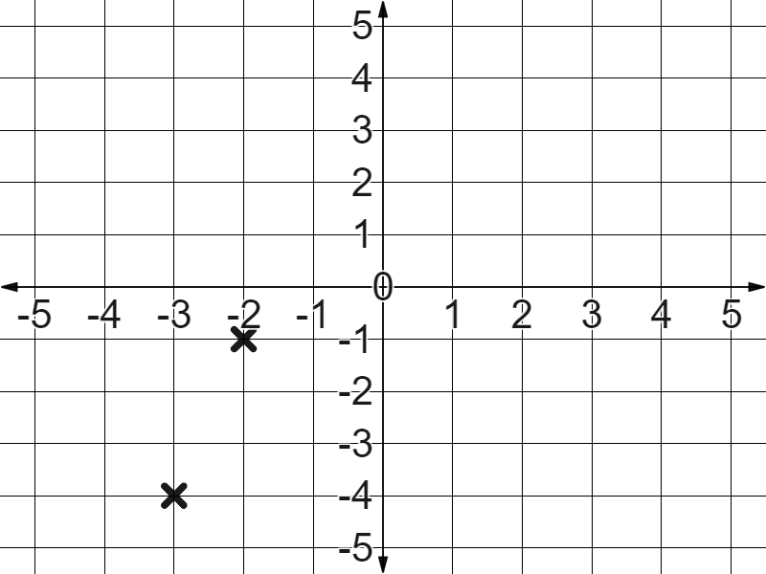
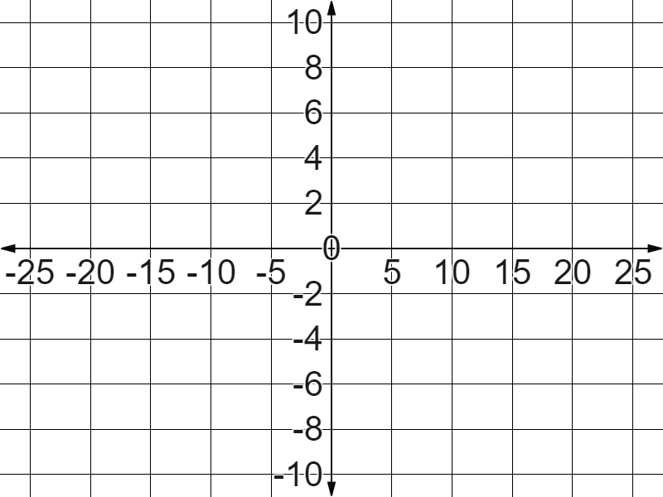
Securing understanding of plotting coordinates
Task A: Plotting coordinates in all four quadrants
1) Plot the below coordinates:
(1, 4)
(-1, 4)
(-4, 1)
(-4, -1)
(4, -1)
(0, -4)
2) In Laura’s book, you see that she has plotted the coordinates (2 ,-1) and (-3, 4) like this.
Task B: Drawing axes
1) Fill in the blanks to label this coordinate grid, keeping the scale in ones.
Don’t forget to start with the origin and work outwards.
2) Fill in the blanks to label this coordinate grid.
Be sure to keep the scale along each axis consistent.

Slide 2
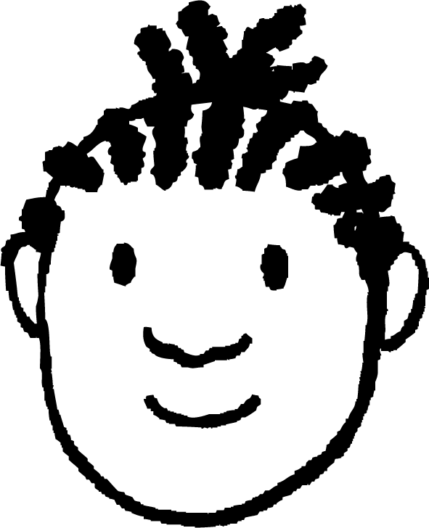
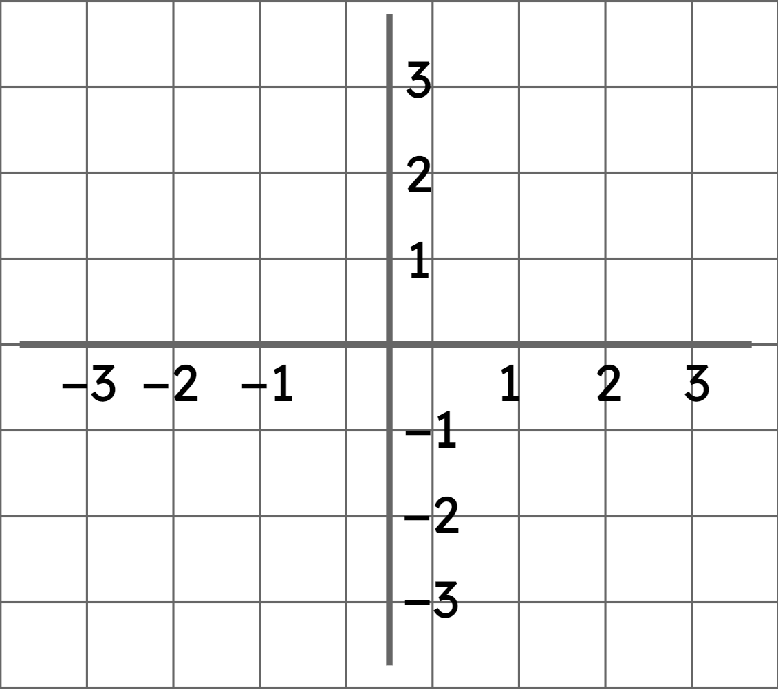
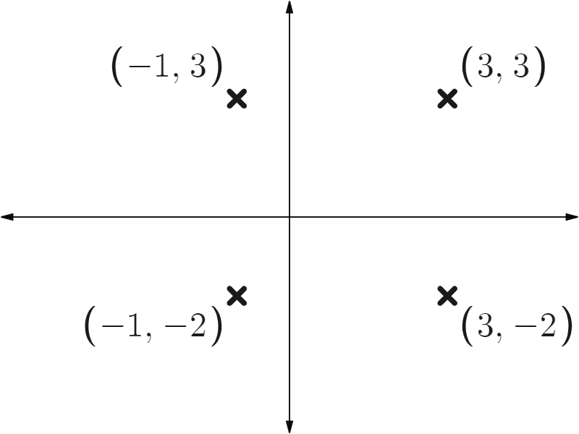
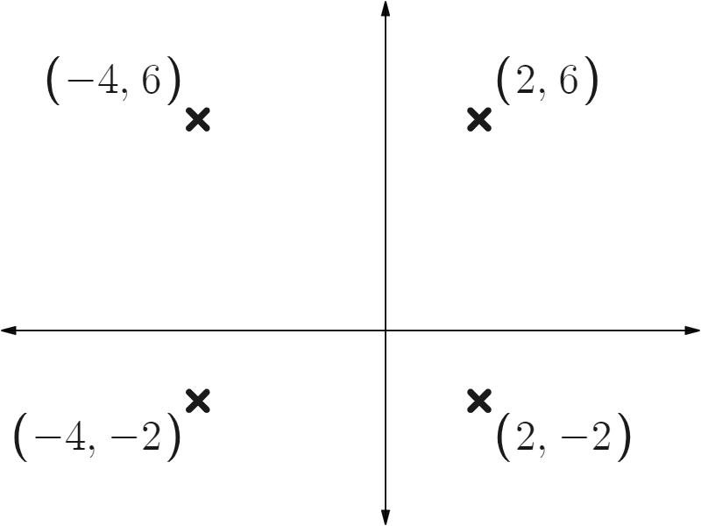
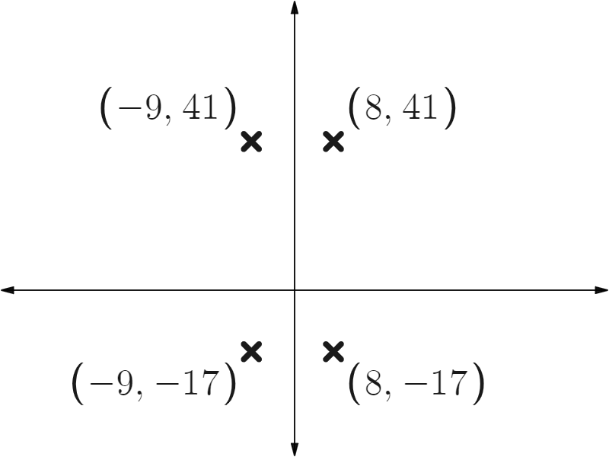
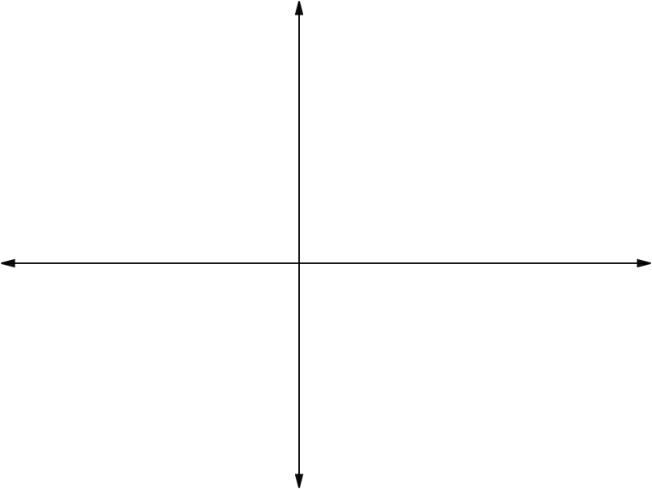
Securing understanding of plotting coordinates
3) You see this in Jacob’s book.
What advice would you give him to improve his work?
Task C: Plotting shapes in all four quadrants
1) Plot these coordinates.
What shape do they form?
(3, 1)
(-2, 1)
(-2, -3)
(3, -3)
2) Fill in the blank coordinates of these rectangles.
a)
b)
c)
d)
(c, b)
✖
✖
(a,b)
(c,d)
✖
✖
(a, d)
Mathematics in Education and Industry.
v2.1

